Slide 1
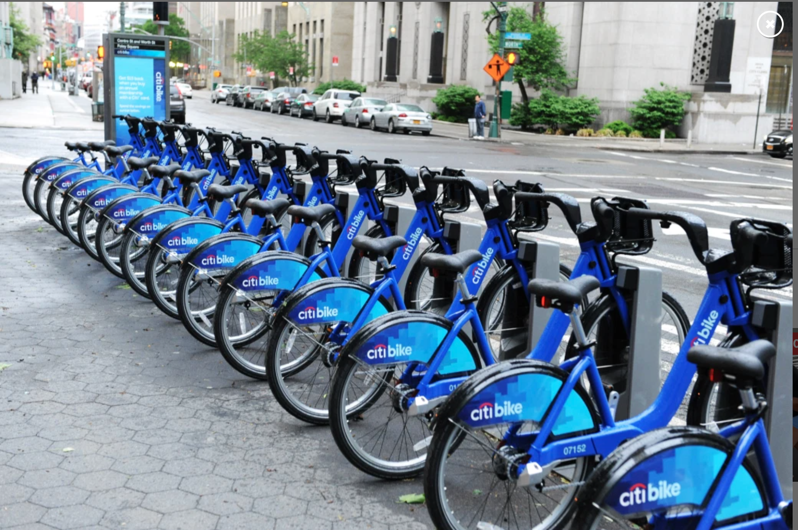
Citi Bike
Thomas Natoli, Rohan Khan, Pooja Patel, Alicia Smith

Slide 2

Citi Bike Overview
Nations largest bike share program that serves as an alternative to other transportation options
The service is designed to help riders get to their destination
Affordable
Convenient
Offers health and environmental benefits

Slide 3
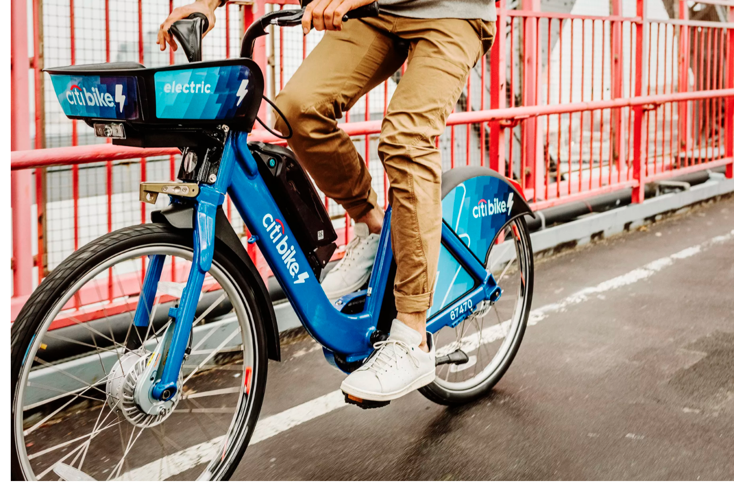
Research objectives
Compare 2019 and 2020 usage in Jersey City, NJ to see what impact Covid-19 had had on the service.
Specifically we are going to compare:
Number of rides taken
Average trip duration per month
Number of subscribers vs. customers using the service
Use of service by gender
Use of service by age
Most popular start and end stations
Most used bike id’s
Most popular routes

Slide 4
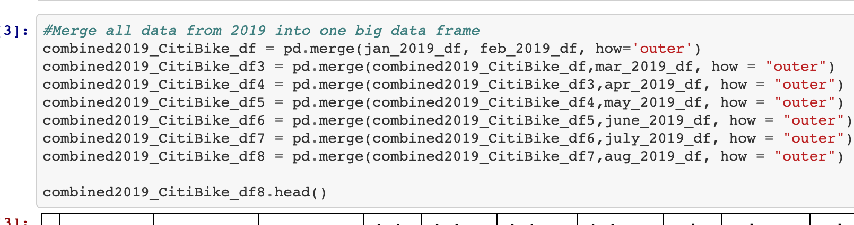
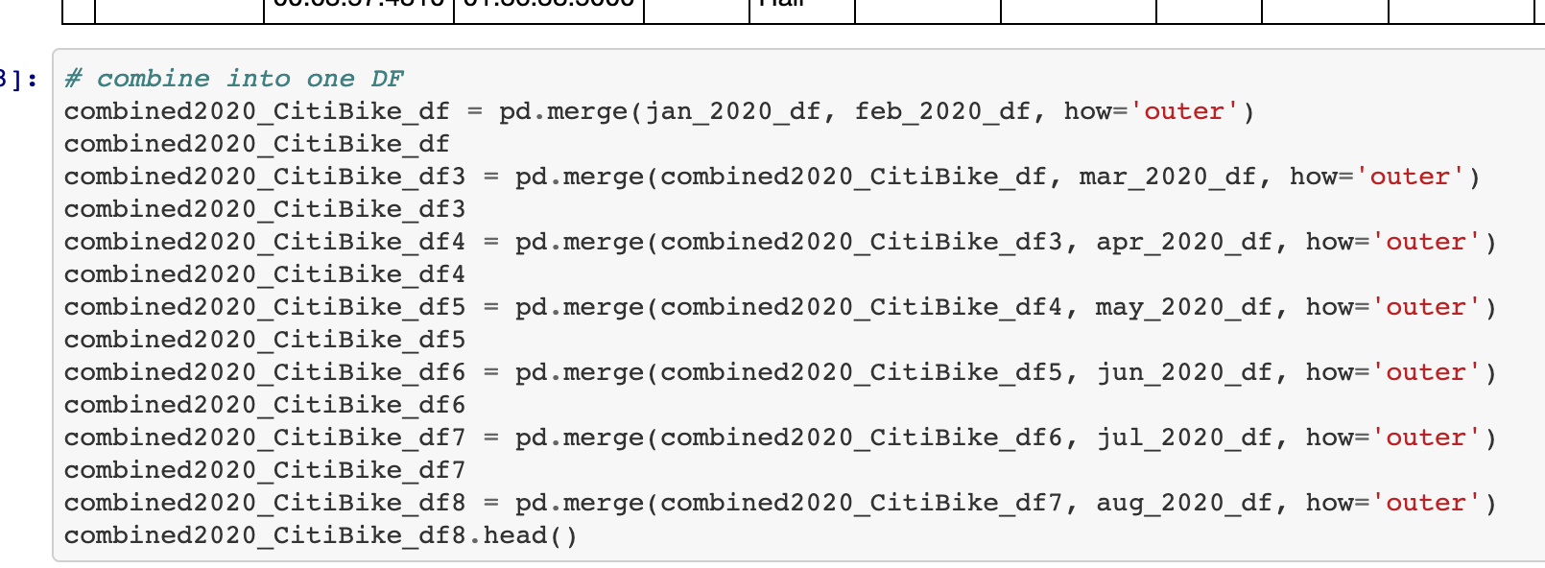
Data Sources
Citi Bike provides trip information directly from website in the form of CSV files
16 files were used

Slide 5
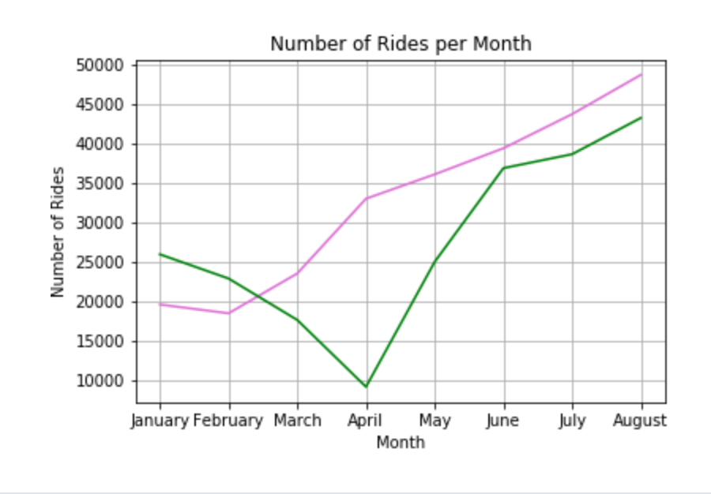
Number of Rides Taken
2019 total rides = 262,925
2020 total rides = 219, 914
Notes:
The first thing that we analyzed was the comparison of number of rides for January – August of 2019 and 2020. We were able to gather the information using a code that obtained the total count of rides for both 2019 and 2020.
In 2019, 262,925 rides were taken and in 2020, 219,914 rides were taken
There were 43,011 less rides taken in 2020 which we can assume was due to Covid-19
The below line chart shows that the major drop in usage occurred in April of 2020. There were only 9,200 rides taken in April in 2020 where there were around 33,000 taken in April of 2019.

Slide 6
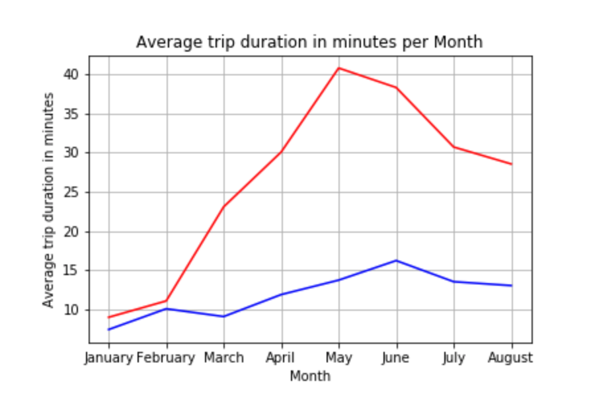
Average Trip Duration
Average trip duration 2019
Average trip duration 2020
Notes:
The next thing we analyzed was the average trip duration for both years. We were able to gather the information by adding the trip duration for each month and dividing it by number of rides taken each month. We converted the time to minutes for readability purposes.
The blue line represents 2019 and the average trip duration was around 15 minutes from January to August of 2019
The red line represents 2020 and the average trip duration was higher than 2019.
We came to the conclusion that the bike sharing program was most likely being used for people to commute to work where the service was probably being used for leisurely purposes in 2020 so people could get out of their house.

Slide 7
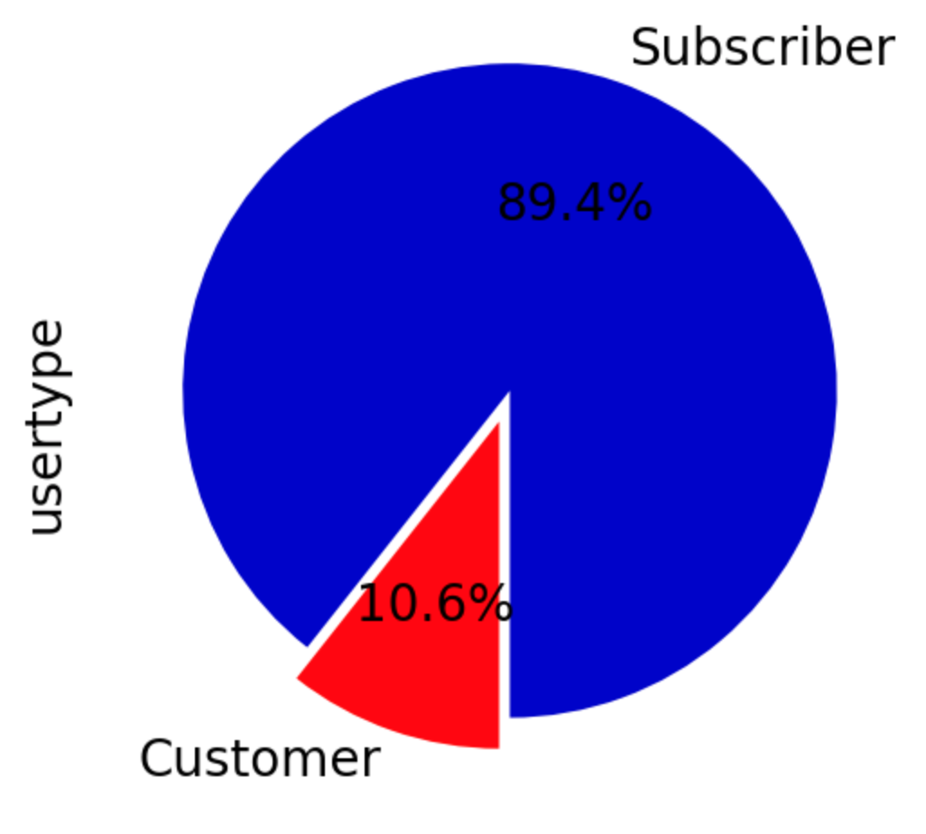
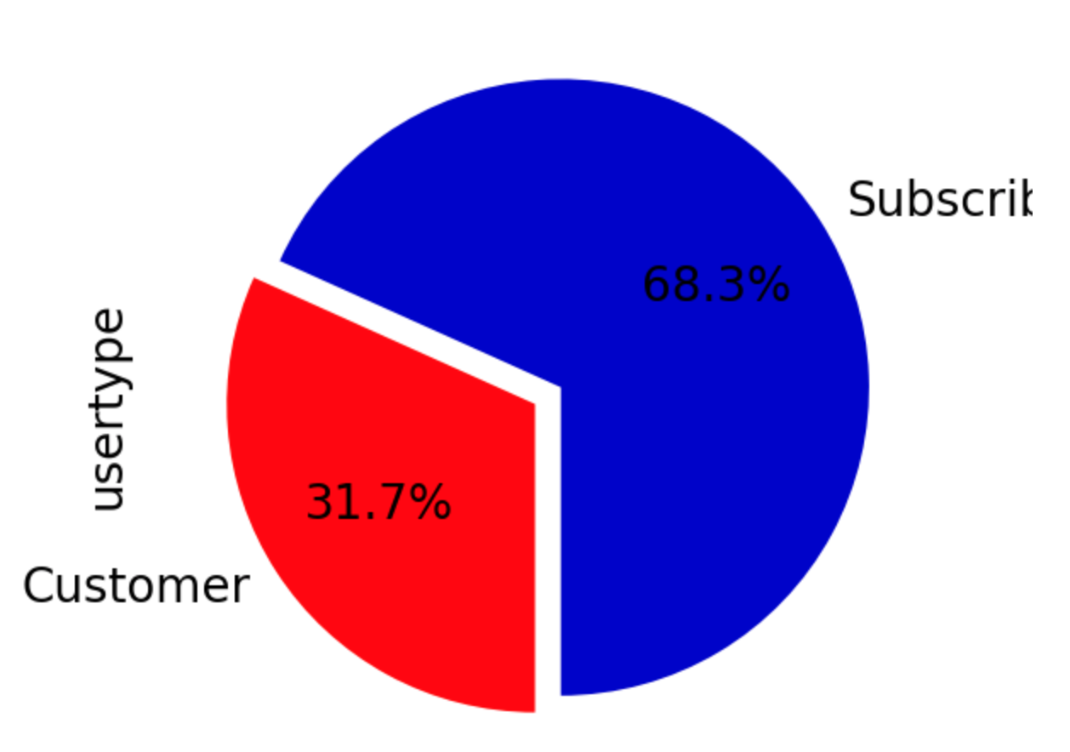
Subscribers vs. Customers
2019
2020
Notes:
CitiBike has 2 membership options
Subscribers
Different membership options
Customer = day pass or 3-day pass
Subscriber = annual pass
Customers
Talk about our assumptions here

Slide 8
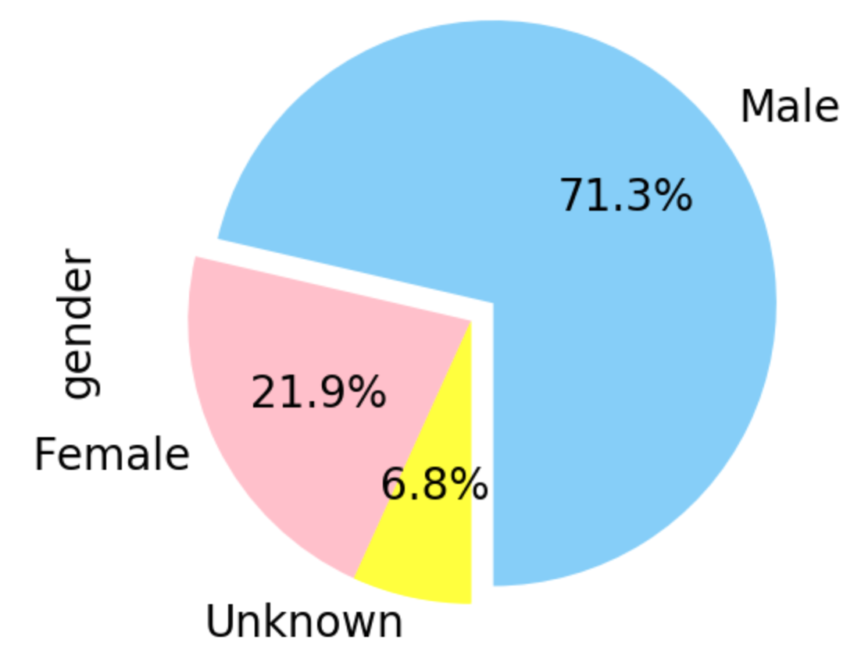
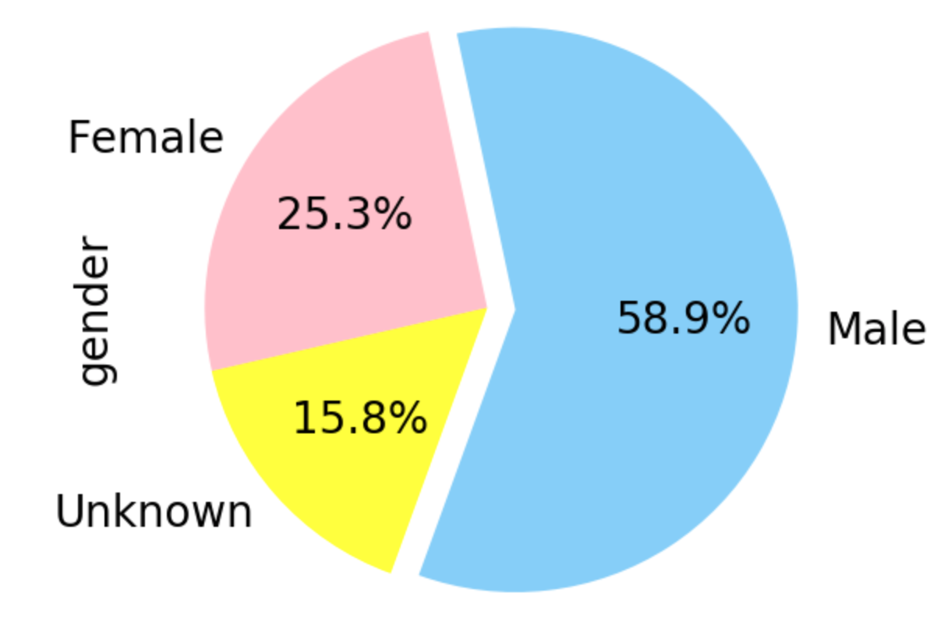
Male vs. Female
2019
2020

Slide 9
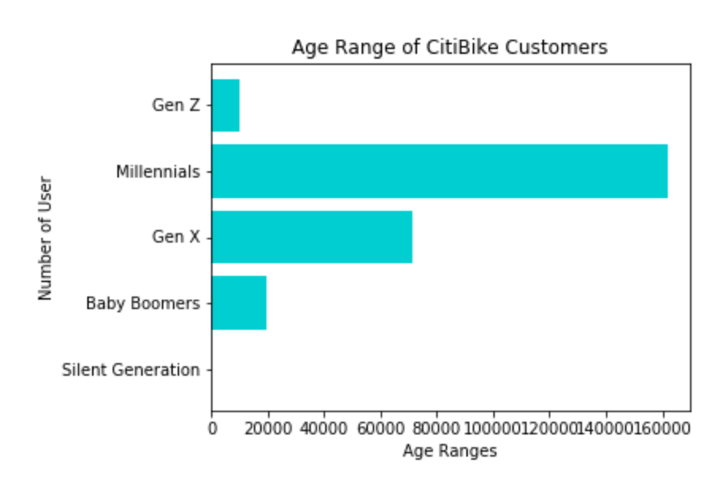
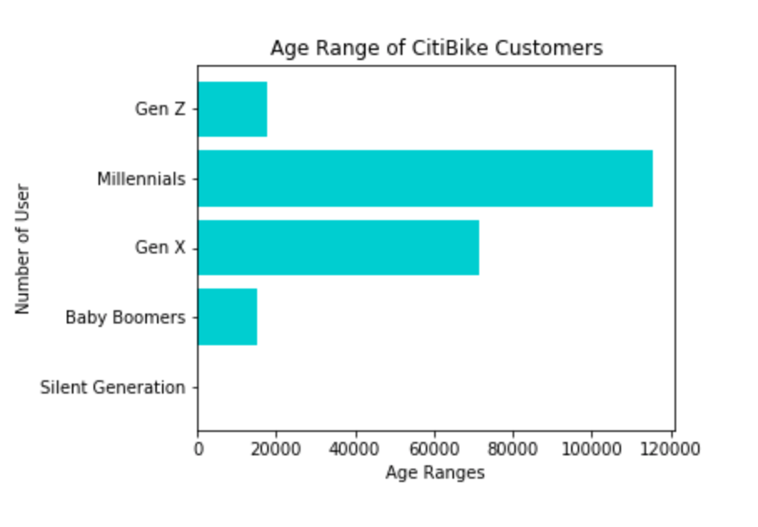
Use of service by Age
2019
2020
Notes:
Age- we wanted to see what age group was using the service. We used binning to bin the different ages into 5 categories. We broke the use by the Silent Generation, Baby Boomers, Gen X, Millennials, and Gen Z. As you see here, millennials use the service the most for both 2019 and 2020. There was an uptick of use by Gen Z in 2020.
We weren’t surprised to see a decrease in use by the baby boomers in 2020 since they are categorized as high risk for Covid-19.

Slide 10
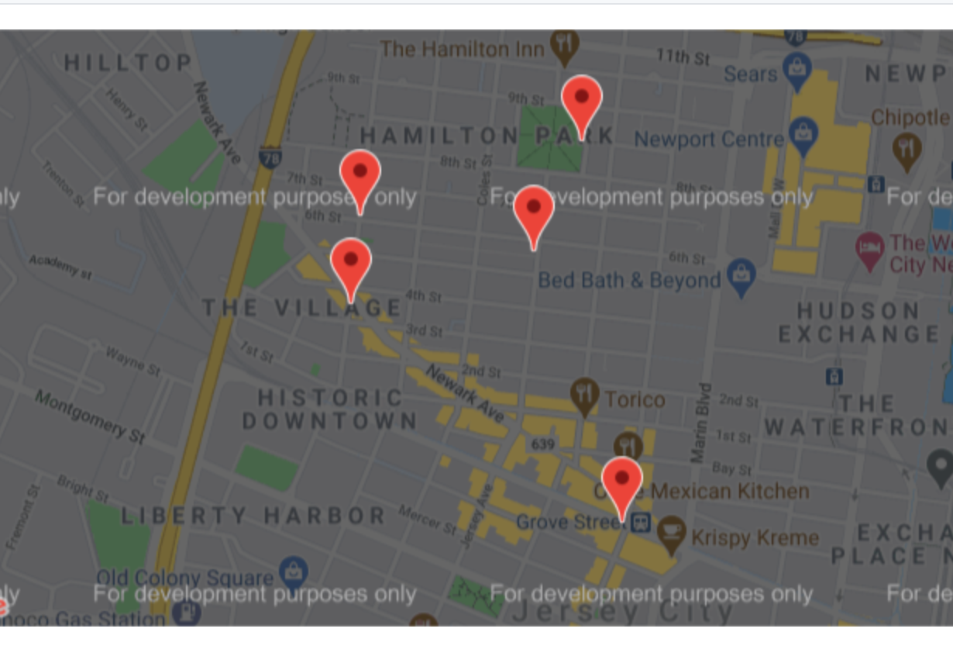
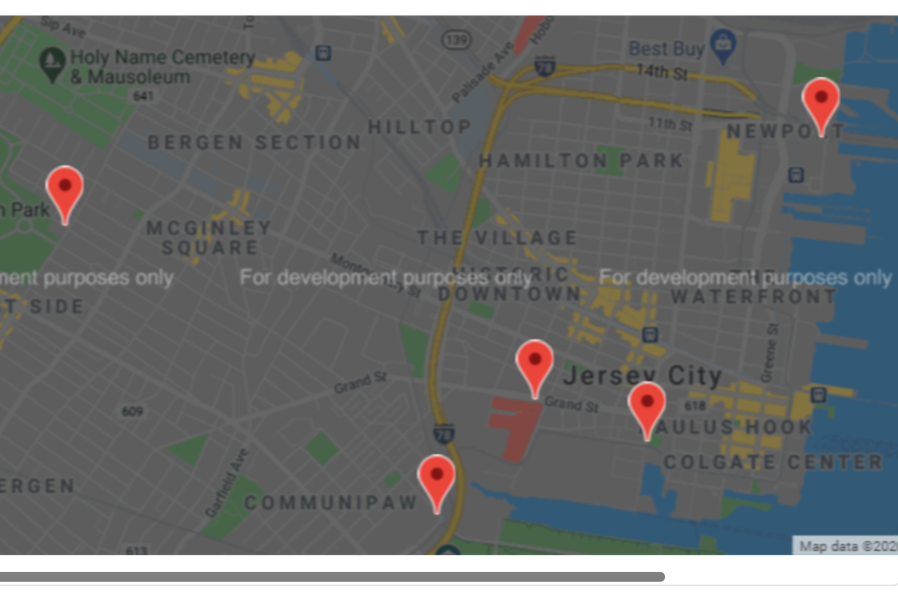
Most popular start stations
2019
2020
Notes:
We next analyzed the most popular start and end stations. We were able to groupby start and end stations and then use an API to obtain a map of Jersey City with the Start locations and end locations for both 2019 and 2020.
We weren’t surprised with that the Grove St. Path was the most popular start and end destination for 2019 and 2020. Many people travel directly into NYC daily from this station.

Slide 11
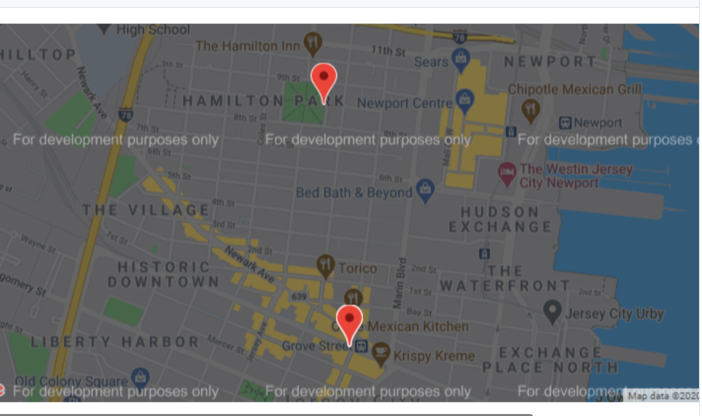
Most popular end stations
2019
2020
Notes:
We next analyzed the most popular start and end stations. We were able to groupby start and end stations and then use an API to obtain a map of Jersey City with the Start locations and end locations for both 2019 and 2020.
We weren’t surprised with that the Grove St. Path was the most popular start and end destination for 2019 and 2020. Many people travel directly into NYC daily from this station.

Slide 12
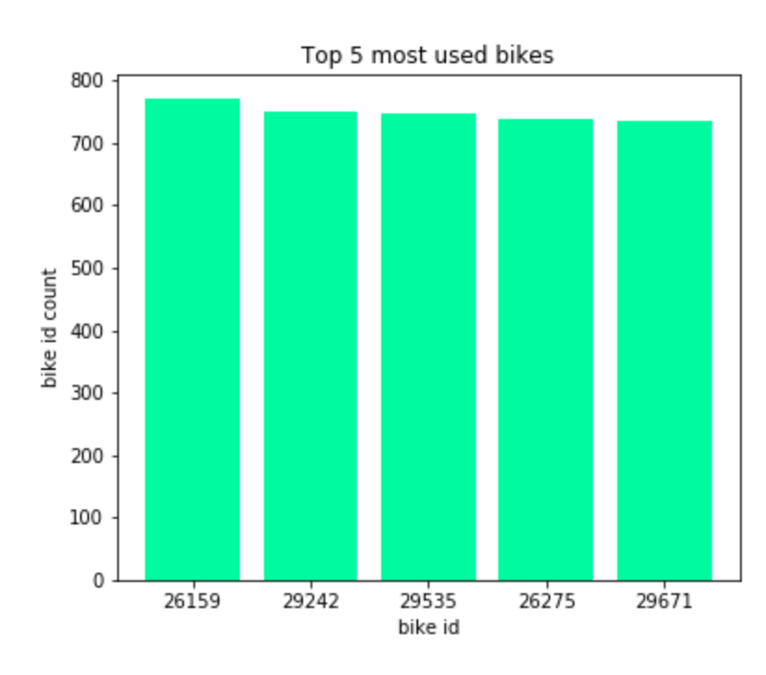
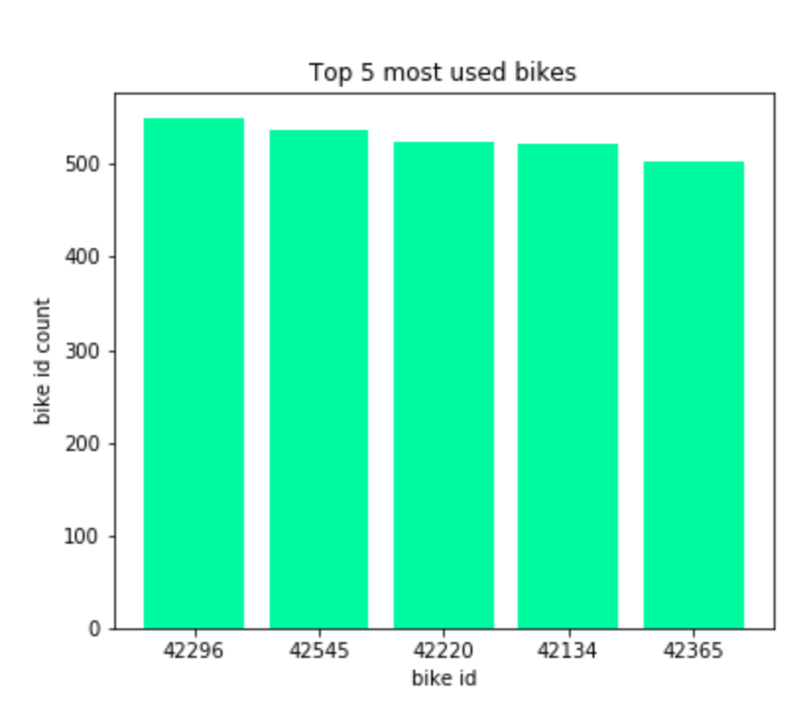
Top Bikes used
2019
2020

Slide 13
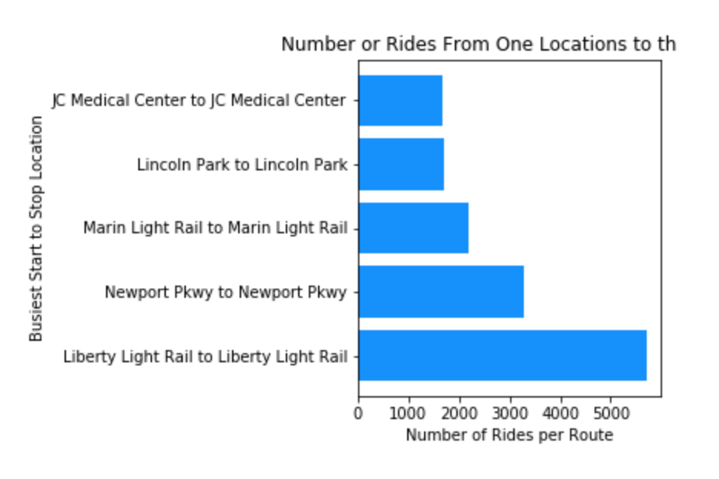
Most popular routes
2019
2020

Slide 14
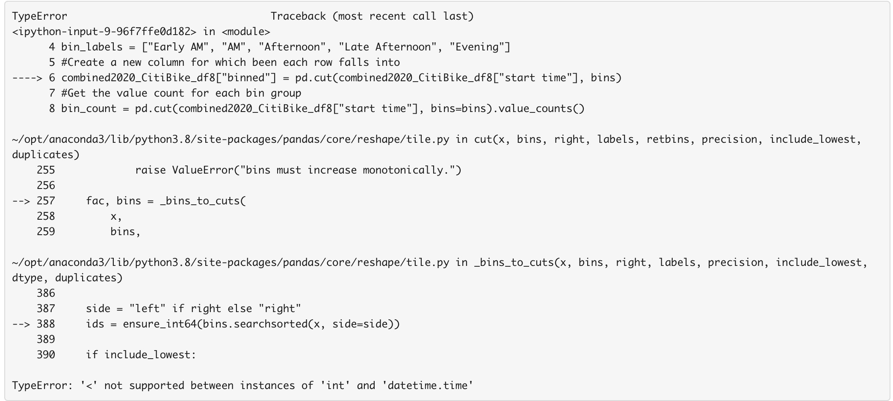
Challenges
We were hoping to gather data around popular times that the service was used for both 2019 and 2020
Notes:
Talk about our issue

Slide 15
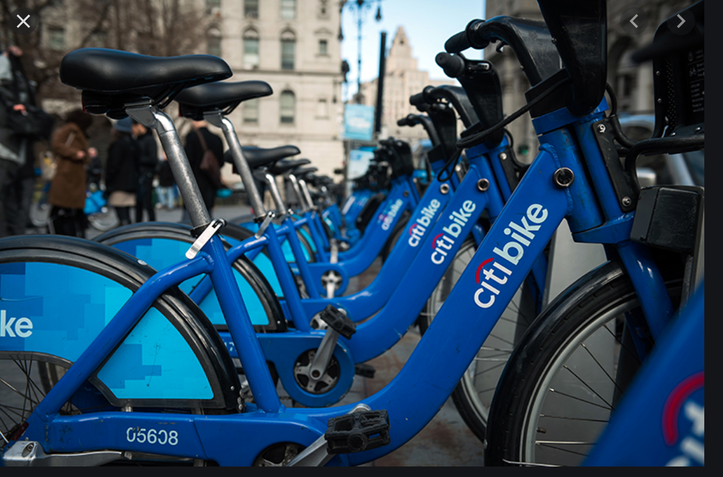
Questions?

